Slide 1

GRAPHICAL SECURITY PASSWORD USING BLOCKCHAIN
Team members
A . Sai Pranay—2010030467
G. Pavan Reddy—2010030501
S . padmashree--2010030508

Slide 2
Contents
Introduction
Literature Survey
Flow Chart
Implementation
Scope
Software & Hardware Requirements
GitHub Setup
Conclusion

Slide 3
Introduction
In a graphical password authentication system, the user has to select from images, in a specific order, presented to them in a graphical user interface (GUI). According to a study, the human brain has a greater capability of remembering what they see(pictures) rather than alphanumeric characters.
Using pictures as passwords. Graphical password schemes are proposed as a possible alternative to text-based schemes, partly motivated by the actual fact that pictures may be remembered better than text;
With everything turning online, the risk of cybercrimes and privacy breaches is also increasing. Passwords play a huge role in keeping your data safe online as well as offline platforms. Passwords are the default method of authentication to get access to our accounts. There are various types of authentication available for users to secure their accounts.

Slide 4
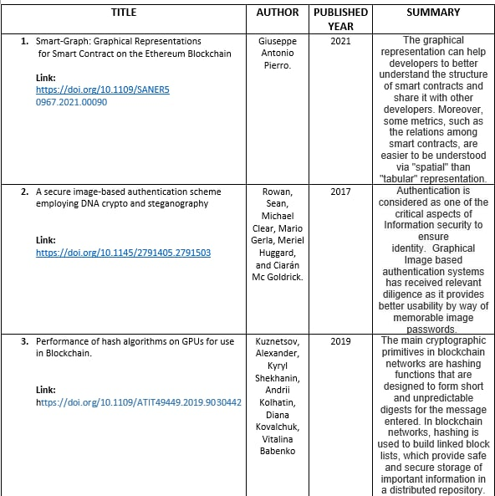
Literature Survey

Slide 5
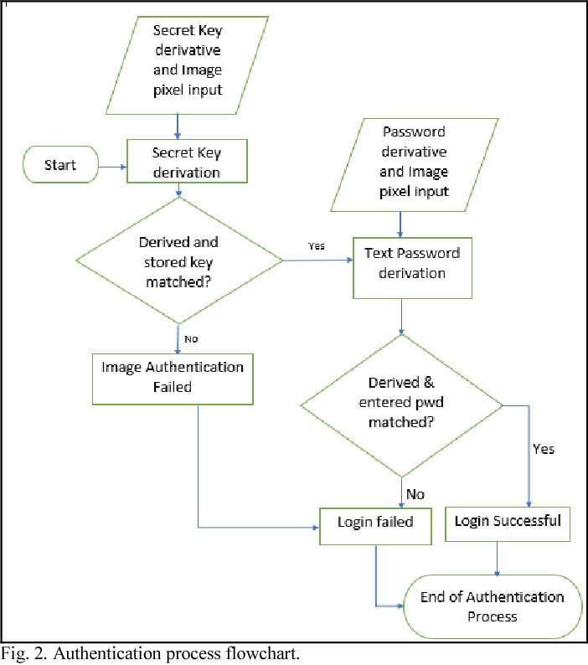
Flow Chart

Slide 6
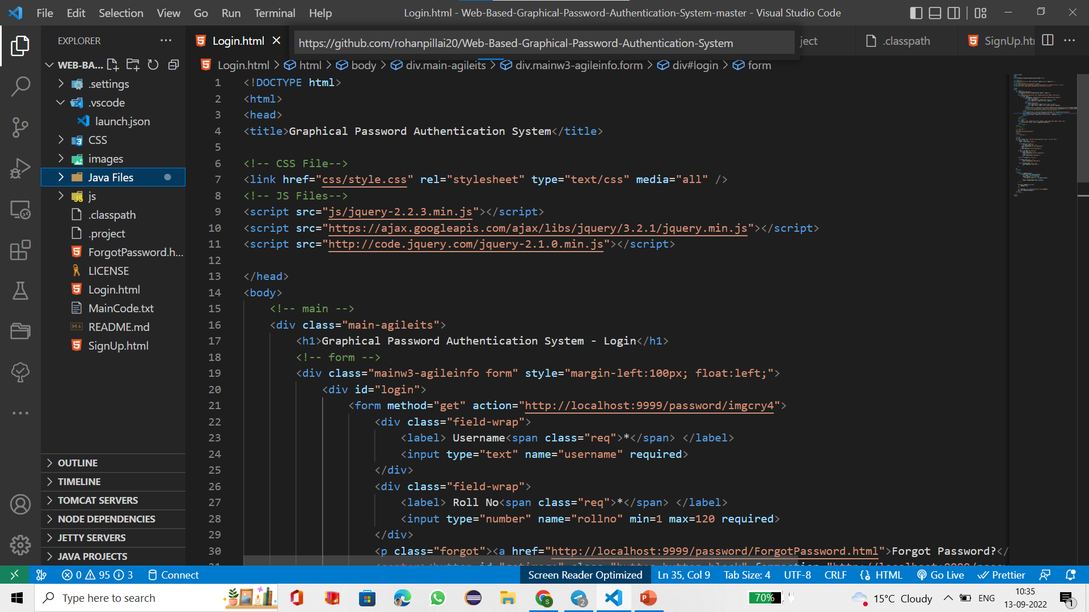
Implementation

Slide 7
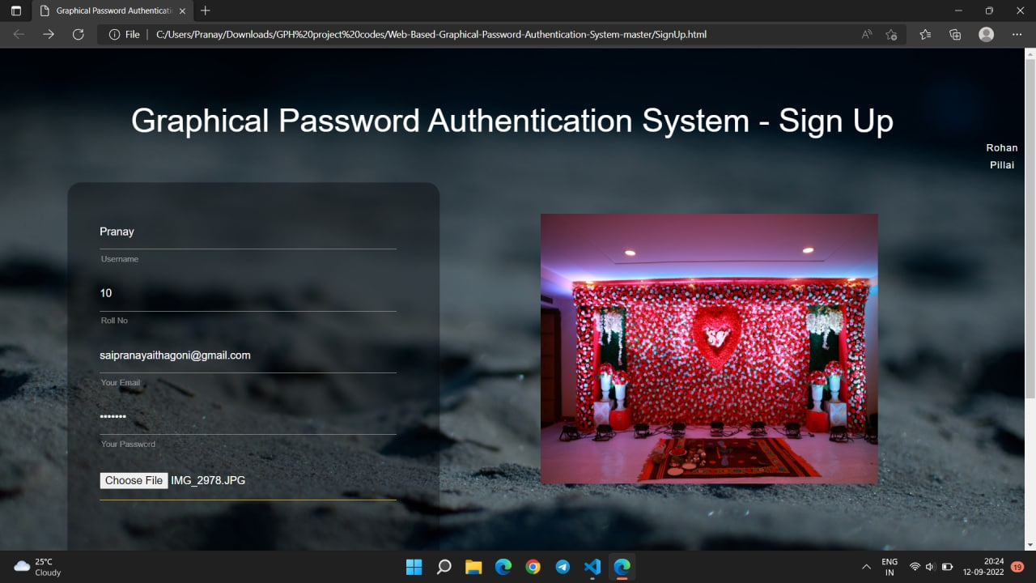
OUTPUT

Slide 8
Software & Hardware Requirements
HARDWARE REQUIREMENTS:
System : Pentium Dual Core.
Hard Disk : 2.80 GB.
Monitor : 15’’ LED
Input Devices : Keyboard, Mouse
Ram : 4 GB
SOFTWARE REQUIREMENTS.
Operating system : Minimum Windows 7.
Coding Language : JAVA, Solidity.
IDE : Eclipse, Mata Mask Wallet , VS code.

Slide 9
Scope
It can be used everywhere instead of text-based password . We can increase the security of this system by increasing the number of levels used, the number of tolerance squares used. Presently there are many authentication system but they have their own advantages and disadvantages.

Slide 10

GitHub Setup
GitHub Link:-
https://github.com/KLH-university/GRAPHICAL-SECURITY-PASSWORD-USING-BLOCKCHAIN/projects?type=new

Slide 11
Conclusion
Although the main use for graphical passwords is that people are better at memorizing graphical passwords than text-based passwords, the existing user studies are very limited and there is not yet convincing evidence to support this argument.

